Slide 1
Chapter 4 USER RESEARCH

Slide 2
User Research
User research is the methodic study of target users—including their needs and pain points—so designers have the sharpest possible insights to work with to make the best designs.
User researchers use various methods to expose problems and design opportunities, and find crucial information to use in their design process.
Examples include user interviews, field studies, usability testing, and customer calls.
It's important to use a mixture of both quantitative and qualitative methods to come to a holistic understanding of the user and problems to be solved.

Slide 3
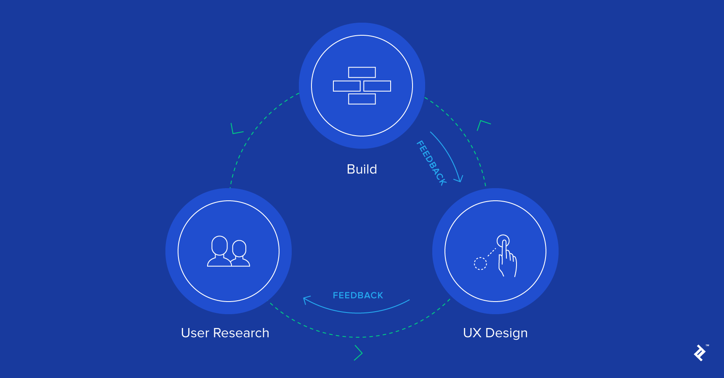

Slide 4
Understanding Your User
In order for website and applications to be successful, designers and developers should start with understanding its intended audience.
The product should be optimized around helping users complete their tasks as easily as possible.
Time invested in discovering end user goals, needs, and tasks both ensures that end products will deliver value and mitigates many risks, including making sure that features are prioritized and built correctly.

Slide 5
Understanding Users
Understanding as much of the context as possible gives you the best chance of meeting users’ needs in a simple and cost effective way.
Focus on the user and the problem they're trying to solve, not a particular solution.
Test your assumptions early so you can reduce the risk of building the wrong thing.
Perform user research and analysis to understand what users need building quick and then throwaway prototypes to test the hypotheses.

Slide 6
What Are User Goals?
User Goals are descriptions of end states that users want to reach.
Mapping a user’s journey toward meeting their goal, including steps taken before and after using a website or application, can be helpful to generate insight.
A website that makes all of its content findable and all of its interactions intuitive may be usable, but it won’t be useful unless it is relevant to an actual goal a user has.
Designers and site owners should understand user goals before any design or development occurs.
One of the most substantial risks to a development project is building the wrong product and only understanding user goals mitigates that risk.

Slide 7
Eliciting User Goals
A variety of methods exist for eliciting user goals, each with strengths or drawbacks.
Asking project stakeholders (people who are not end users but who nevertheless have invested in the project’s success) is not an optimal way of finding user goals.
Stakeholders — even ones that interact with users directly — often have goals that are different from and even in tension with users.
Stakeholders’ perspective are important for the project, but they should not be considered a definitive source of user goals.
Asking users themselves, such as through user interviews, focus groups, or surveys, can be a better way of discovering.

Slide 8
Context of use
Context of use focuses on where, when, how and why users are performing a task, reaching a goal or using your product or service.
The Context of Use is the actual conditions under which a given artifact/software product is used, or will be used in a normal day to day working situation.
It is important to carry out walkthroughs, usability tests, prototyping sessions, meetings, user studies in the context of use to get as high validity of your findings as possible.

Slide 9
Context of use
Context holds the key to differentiated user experience.
Context frames all experience.
If you didn't understand the user will be using your app mostly on mobile, but designed for desktop, ease of use wouldn't save you.
Context sets the expectation, spoken and unspoken for user interaction….It is basically the where and how you take your user to the feature or touchpoints.
To understand the context we can conduct: Contextual Interview

Slide 10
Few real examples to illustrate context of use
At a medical billing office, we observed stacks of bills on a user's desk. "I want these digitized or on an iPad...I want to see which ones I have done and then keep a copy for auditing purposes".
For a mobile app aimed at students, users wanted a secret or parallel communication channel or codewords that parents would not detect. One user reminded us, “That’s why teens use SnapChat, to keep communication discreet and private”.
In a restaurant, the manager wanted a large summary of end-of-day earnings she could glance at from a 5-foot distance, while walking past the display in near dark conditions, during store closing.

Slide 11
Usability
The extent to which a product can be used by specified users to achieve specified goals with effectiveness, efficiency, and satisfaction in a specified context of use"
Five characteristics of usability which must be met for the users of a product:
Effective
Efficient
Engaging
Error Tolerant
Easy to Learn

Slide 12
Effective
Effectiveness is the completeness and accuracy with which users achieve specified goals.
It is determined by looking at whether the user’s goals were met successfully and whether all work is correct.
The more informative an interface can be, the better users are able to work in it without problems.
The effectiveness of an interface often relies on the presentation of choices in a way that is clearly understandable to the user.
Not all tasks require efficiency to be the first principle.
For example, in interfaces to financial systems (such as banking machines), effective use of the system -- withdrawing the correct amount of money, selecting the right account, making a transfer correctly – are more important than marginal gains in speed.

Slide 13
Efficient
Efficiency can be described as the speed (with accuracy) in which users can complete the tasks for which they use the product.
ISO 9241 defines efficiency as the total resources expended in a task.
Navigation design elements such as keyboard shortcuts, menus, links and other buttons all have an impact on efficiency. When they are well-designed, with clearly expressed actions, less time and effort are needed for the user to make navigation and action choices.
Making the right choices for efficient use of the software depends on an understanding of the users and how they prefer to work.
For example, are they likely to use the interface infrequently or to be habitual users who might learn hidden controls and shortcuts?
Do they use the keyboard, mouse or other input devices?
Keyboard shortcuts can be extremely efficient for proficient users who work with the interface intensively. If they are the primary interaction tool, they can slow down users who are unfamiliar with them, or with the software.

Slide 14
Engaging
An interface is engaging if it is pleasant and satisfying to use.
The visual design is the most obvious element of this characteristic.
The style of the visual presentation, the number, functions and types of graphic images or colors (especially on web sites), and the use of any multimedia elements are all part of a user’s immediate reaction.
The design and readability of the text can change a user’s relationship to the interface as can the way information is chunked for presentation.
Equally important is the style of the interaction which might range from a game-like simulation to a simple menu-command system.
The style of engagement that is satisfying for a repetitive work tool is different than an e-commerce site.
Even within the same class of interfaces, different users may have widely divergent needs. What is important is that the design meet the expectations and needs of the people who must use the interface.

Slide 15
Error Tolerant
The ultimate goal is a system which has no errors. But, product developers are human, and computer systems far from perfect, so errors may occur.
An error tolerant program is designed to prevent errors caused by the user’s interaction, and to help the user in recovering from any errors that do occur.
Errors might also occur because the designer did not predict the full range of ways that a user might interact with the program.
Note that a highly usable interface might treat error messages as part of the interface, including not only a clear description of the problem, but also direct links to choices for a path to correct the problem.
For example, if a required element is missing simply presenting a way to fill in that data can make an error message look more like a wizard.

Slide 16
Some guidelines for preventing errors are:
Make it difficult to take incorrect/ invalid actions:
Design links and buttons to be distinctive, use clear language, avoiding technical jargon, and be sure that dependent fields or choices appear together.
Limit choices when possible to those which are correct, provide clear examples for data entry, present only appropriate navigation options.
Make it difficult to take irreversible actions:
Provide the ability to back track, provide means to undo or reverse actions, avoid dead-end screens.

Slide 17
Easy to Learn
Learning goes on for the life of the use of a product. Users may require access to new functionality, expand their scope of work, explore new options or change their own workflow or process.
An interface which is easy to learn allows users to build on their knowledge without deliberate effort.
This goes beyond a general helpfulness to include built-in instruction for difficult or advanced tasks, access to just-in-time training elements, connections to domain knowledge bases which are critical to effective use.
Allow users to build on not only their prior knowledge of computer systems, but also any interaction patterns they have learned through use in a predictable way.
Predictability is complementary to interface consistency.
A consistent interface ensures that terminology does not change, that design elements and controls are placed in familiar locations and that similar functions behave similarly.
Predictability expands this to place information or controls where the user expects it to be.

Slide 18
Connection to usability goals
For example, A typical web knowledge management system is used by employees
Effective - "Less than 5% of the registrations will have errors, omissions or inconsistencies requiring a follow-up contact by the staff.“
Efficient - "The user will be able to successfully complete the registration in under 3 minutes"
Engaging - "At least 80% of employees will express comfort with using the online system rather than visiting the HR office."
Error Tolerant – "The system will validate all housing, meal and tutorial choices and allow the user to confirm pricing for these options before completing the registration."
Easy to Learn – "Users will be able to successfully complete a benefits calculation without needing any external instruction or help screens."

Slide 19
To understand the context we can conduct: Contextual Enquiry/Interview
The contextual enquiry research technique combines observation with interview-style question and response.
Participants get to explain their actions or "think aloud" as they work through a task or activity.
Contextual inquiry is a type of ethnographic field study that involves in-depth observation and interviews of a small sample of users to gain a robust understanding of work practices and behaviors.
Its name describes exactly what makes it valuable — enquiry in context:
Context: The research takes place in the users’ natural environment as they conduct their activities the way they normally would. The context could be in their home, office, or somewhere else entirely.
enquiry: The researcher watches the user as she performs her task and asks for information to understand how and why users do what they do.

Slide 20
What You Learn From Contextual Interviews
By going to the user, you see the user's environment and the actual technology the user works with.
As a result, you’ll be able to answer questions such as:
Any issues that users are facing
Equipment they are working with
How their space is set-up
Preference between mouse and keyboard`
The type of internet connection they have
How long does it take to complete common or target tasks
Whether there are people there and willing to assist the user if they need help completing a task

Slide 21
Combining Contextual Interviews and Usability Testing
In a usability test, you usually have all users try to complete the same scenarios resulting in comparative data from several people trying the same thing. In contextual interviews you watch people’s behavior in their own environment doing their own tasks.
However, you can combine contextual interviews and usability testing by:
Combine watching users do their own work in their environments with asking them to try a few of your tasks.
Interview users during a usability tests to find out the sorts of questions, issues, tasks they would come to the site with.

Slide 22
Why Conduct Contextual Enquiry
﻿The contextual-inquiry method was developed by Hugh Beyer and Karen Holtzblatt as a way to resolve the drawbacks of other qualitative-research methodologies such as surveys and interviews.
Methodologies like surveys and interviews rely on the users’ ability to recall and explain a process that they are removed from in that moment.
People attempt to summarize their processes, but important details like reasoning, motivation, and underlying mental models are left out of this summary, leaving researchers with only a superficial understanding of the users’ approach to the activity.
However, users can easily talk about what they are doing and why ,when they are doing it. ﻿For this reason, contextual inquiry can provide richer and more relevant information about how users complete processes than self-reported or lab-based research methods do.
One of the greatest strengths of this methodology is that you get to see things you wouldn’t anticipate and uncover low-level details that have become habitual and invisible.
You get to see the interruptions, superstitious behaviors, and illogical processes that directly influence UX work.

Slide 23
Hide this slide…only example
I was once redesigning the data-entry portion of a software tool used to create auto-insurance policies.
First, I interviewed several specialists about how they entered vehicle data for entire fleets of commercial vehicles into the software. All three of the specialists I interviewed reported copying large batches of vehicle data from a spreadsheet and pasting it into a data table within the software interface.
Later, I went to observe and interview some of these specialists as they did this process. What I discovered is that there were several other steps involved that they hadn’t mentioned. They were also crossreferencing a screen from another software tool to fetch several missing pieces of correlating information that needed to be input for each vehicle. They also hit the Save button habitually after every piece of data that was manually entered, even though the program autosaved their progress. They were either not aware or did not trust that the data was saved.
These were both significant insights that influenced the design of the new tool.

Slide 24
Case Study
https://centralis.com/casestudies/mercury
https://medium.com/@megmcneilly/case-study-connecting-hotel-guests-and-the-value-of-contextual-observations-8350390cb0f3

Slide 25
4 Grounding Principles
Contextual enquiry is based on 4 principles that help researchers adjust and apply the apprenticeship model to the context of their products and work.
Context: The researcher should observe in the natural environment.
Partnership: The user and researcher are partners in the process of understanding the work.
Interpretation: The researcher should develop a comprehensive and shared interpretation for all important aspects of the work, aided by feedback from the user.
Focus: The researcher should understand the purpose of the research project and what information should be sought. This understanding guides the observation and the interviews during sessions.

Slide 26
4-Part Session Structure
Select participants that are uniquely qualified and knowledgeable in the area you need to understand. Then, use the following 4-part structure as a template to guide your approach.
The primer
The primer is meant to ease the participant into the session. Starting casually allows your participant to become comfortable with you and learn what to expect from the session.
Introduce yourself and take some time upfront to build rapport with your participant.
Indicate what you hope to achieve during the interview and that you expect the participant to correct any misinterpretations you may develop as you learn.
Discuss confidentiality and get approval for any filming or recording you may be doing.

Slide 27
4-Part Session Structure(contd.)
The transition
When finished with the introduction and general interview, make an explicit and clear transition into the contextual interview portion of the meeting.
Let the user know that you will watch while he/she goes about his/her work and that he/she should expect you to interrupt whenever you see something interesting to discuss.
If it is a bad time for interruption, he/she should communicate this to you and continue until a better stopping point.

Slide 28
4-Part Session Structure(contd.)
The contextual interview
This phase usually goes through multiple iterations.
Watch and learn.
Stop and initiate discussion when the user does something you don’t immediately understand or when you want to confirm an interpretation.
Try to understand underlying processes.
Explain your interpretations of their tasks and workflow for the users to confirm or correct.
You should initiate discussion for 2 reasons:
If you’ve observed something you don’t understand. In this case, ask open-ended questions and let the participant give you details about why she took a certain action.
To allow the participant to validate or invalidate your understanding of the user’s mental model

Slide 29
4-Part Session Structure(contd.)
﻿Wrap up
Ask any final clarifying questions.
Review your notes and summarize what you took away from the interview by explaining your interpretation of the observed processes.
This is your users’ chance to give final clarifications and correct your understanding.
The time required for a contextual-inquiry session will depend on the scope context of the work you are intending to understand. They can range from an hour or two to several days of observations and interviews.

Slide 30
Conclusion
After contextual-enquiry sessions have been completed, researchers and designers should come together to share findings and interpret the results of the interviews.
Workshop exercises for finding ideas in qualitative data, through affinity mapping.
Contextual enquiry is often coupled with task analysis.
In the end, teams should walk away with a shared understanding of users’ work processes, mental models, and common behaviors, so they are prepared to design solutions for their customers

Slide 31
Interviews
Interviews are a "guided conversation where one person seeks information from the other."
An interview may be conducted in conjunction with other requirements-gathering activity such as a site visit, or as a solo activity.
Interviews may be conducted remotely (via the phone), or face to face.
A structured interview is one where the list of questions is prepared in advance and the researcher tries to solicit answers from all participants.
A non-directed interview is one where the interviewer primarily listens to the subject and provides minimal input or direction.

Slide 32
Why Do User Interviews?
Interviews give insights into what users think about a site, an application, a product, or a process.
They can point out what content is memorable, what people feel is important , and what ideas for improvement they may have.
They can be done in a variety of situations:
before you have a design, to create personas, journey maps, feature ideas, workflow ideas
to enrich a contextual inquiry study by supplementing observation with descriptions of tools, processes, bottlenecks, and how users perceive them
at the end of a usability test, to collect verbal responses related to observed behaviors

Slide 33
Best Practices for Conducting Individual Interviews
Set a goal for the interview(What you want to learn )
Selecting representative participants to talk to.
Hiring a skilled interviewer who knows how to make interviewees feel more comfortable, asks questions in a neutral manner, listens well, and knows when and how to probe for more details
Make the user feel as comfortable as possible. Create a rapport with the user.
Prepare questions before the interview.
Anticipate different responses, and construct follow up questions based on your research goals.
Getting permission to tape the sessions and have one or more note takers

Slide 34
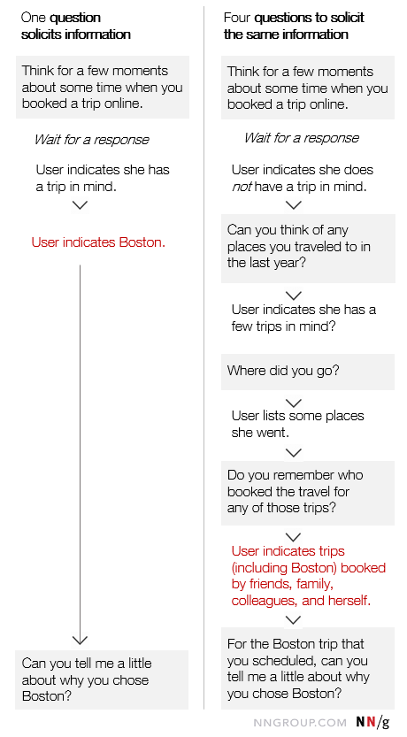
Examples of how two different people might respond to the same question followup questions (in grey boxes) that the interviewer may ask to get to the same place.

Slide 35
Prepare more questions than you believe you will have time to ask.
Some participants like to talk and give very long answers to questions.
Others need prompting in the form of follow up questions to deliver the same amount of information.
Be ready to address both situations.
Practice your go-to follow up questions.
Have at the ready some clear phrases to prompt users to elaborate an answer.

Slide 36
Types of Interviews
Structured interview
Structured interviews have predetermined questions in a set order.
They are often closed-ended, featuring dichotomous (yes/no) or multiple-choice questions.
Asking set questions in a set order can help you see patterns among responses, and it allows you to easily compare responses between participants while keeping other factors constant.
This can mitigate biases and lead to higher reliability and validity.
However, structured interviews can be overly formal, as well as limited in scope and flexibility.
Structured interviews may be a good fit for your research if:
You feel very comfortable with your topic. This will help you formulate your questions most effectively.
You have limited time or resources.

Slide 37
Unstructured interview
An unstructured interview is the most flexible type of interview.
The questions and the order in which they are asked are not set.
Instead, the interview can proceed more spontaneously, based on the participant’s previous answers.
Unstructured interviews are by definition open-ended.
However, so much flexibility means that they can be very challenging to conduct properly.
You must be very careful not to ask questions, leading to biased responses causing lower reliability or even invalidate your research.
Unstructured interviews may be a good fit for your research if:
Your research question is exploratory in nature, and you are seeking descriptive data that will deepen and contextualize your initial hypotheses.
Your research necessitates forming a deeper connection with your participants, encouraging them to feel comfortable revealing their true opinions and emotions.

Slide 38
Semi-structured interview
Semi-structured interviews are a blend of structured and unstructured interviews.
While the interviewer has a general plan for what they want to ask, the questions do not have to follow a particular phrasing or order.
Semi-structured interviews are often open-ended, allowing for flexibility, but follow a predetermined thematic framework, giving a sense of order. For this reason, they are often considered “the best of both worlds.”
However, if the questions differ substantially between participants, it can be challenging to look for patterns, lessening the generalizability and validity of your results.
Semi-structured interviews may be a good fit for your research if:
You have prior interview experience. It’s easier than you think to accidentally ask a leading question when coming up with questions on the fly.
Your research question is exploratory in nature. The answers you receive can help guide your future research.

Slide 39
Limitations of Interviews
Unlike behavioral data that captures how participants interact with a design, data from interviews is self-reported — it reflects users’ perceptions and feelings about a process, a site, or an interaction.
Like any self-reported data interview data is tenuous because:
Human memory is flawed, so people don’t recall events fully or accurately.
Participants don’t know exactly what is relevant for the interviewer, so sometimes leave out details.
Some people are proud or private, others are shy and easy to embarrass. Thus, not everybody will share every detail with a strange

Slide 40
Focus group
A focus group brings together a group of participants to answer questions on a topic of interest in a moderated setting.
A focus group is a group interview involving a small number of demographically similar people or participants who have other common traits/experiences. Their reactions to specific researcher/evaluator-posed questions are studied.
Focus groups are qualitative in nature and often study the group’s dynamics and body language ( not expressed in words e.g., people who appear to have something to add but do not speak up).
The idea is for the researcher to understand participants' reactions. If group members are representative of a larger population, those reactions may be expected to reflect the views of that larger population.
Focus groups can provide more directed and unfiltered/unbiased feedback than individual interviews and are easier to organize than experiments or large surveys.
A focus group may be a good fit for your research if:
Your research focuses on the dynamics of group discussion.
Your questions are complex and rooted in feelings, opinions, and perceptions that cannot be answered with a “yes” or “no.”
Your topic is exploratory in nature, and you are seeking information that will help you uncover new questions or future research ideas.

Slide 41
Interviews are more effective when you need to know about participant’s needs, opinions or decision making processes.
This would typically be used to answer questions like “Why do farmers not use fertiliser?”, “What type of family planning methods are most appealing to women?” or “Does our solar light work in rural households?”.
Focus groups are more effective when you want stakeholders to generate new ideas through brainstorming.
Typical examples of questions that would be suitable include “What ideas do chiefs have that could help improve the project?” or “What can health staff do to fix this problem?”

Slide 42
Competitive analysis
In the world of UX Design, competitive analysis is a critical part of the research process.
Whether it’s a babysitting app, fintech dashboard, or e-commerce site, understanding the landscape of solutions is crucial to the foundation of the solution you are designing.
A competitive analysis provides strategic insights into the features, functions, flows, and feelings evoked by the design solutions of your competitors.
By understanding these facets of competitors’ products, you can strategically design your solution with the goal of making a superior product and/or experience.
A UX competitive analysis should be done prior to starting work on a new project.
Since competitors can emerge at any time or may increase (or improve) their offerings, the competitive research should be iterative and continue as long as you are working on that project.

Slide 43
Considerations for competitive analysis
Create a short list of main comparison criteria before you start. You can always add more criteria if it makes sense.
Start with 3-5 main competitors. Once you uncover the information you need in order to inform your design decisions, it’s time to stop.
Don’t simply copy the designs you find in your research. The competitors may not be using best practices.
Choose the tool that helps you present your findings based on the information you are documenting and sharing.
Know when to perform a “comparative analysis.”
Study solutions from products that are not direct competitors. For example, if you are designing a solution that includes a calendar scheduling feature, explore the best calendar scheduling solutions.

Slide 44
Starting a UX competitive analysis
Some common questions to begin a UX competitive analysis are:
Who is currently trying to solve this problem?
How are they trying to solve the problem?
What their main differentiator or unique value-add is for their business and products
Did anyone try to solve it in the past and fail?
Why did they fail?
Once the main competitors have been identified, conduct a heuristic evaluation of the competitor’s end-to-end user experience.
Here are some common user experiences to evaluate:
Sign up & Login
Ease of account creation
Fast or slow
Hard or easy
Initiating the main task
Performing the main task
Successful completion of the main task

Slide 45
Comparison criteria:
Price
Service offered
Age of audience served
Number of features
Style and design
Ease of use
Type and number of warranties
Customer support offered
Product quality
Product marketing

Slide 46
A competitive analysis report may include:
A description of your company’s target market
Details about your product or service versus the competitors’
Current and projected market share, sales, and revenues
Pricing comparison
Marketing and social media strategy analysis
Differences in customer ratings

Slide 47
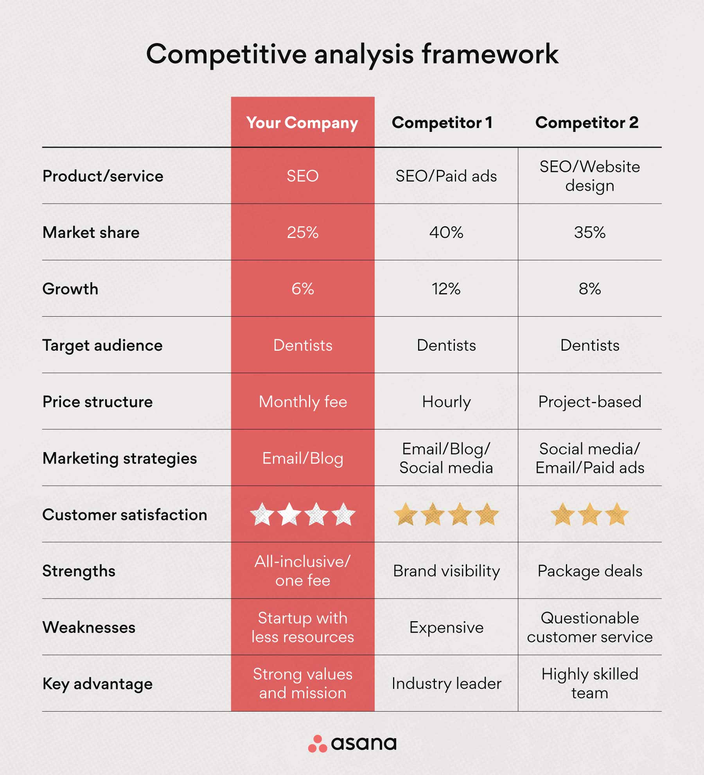

Slide 48
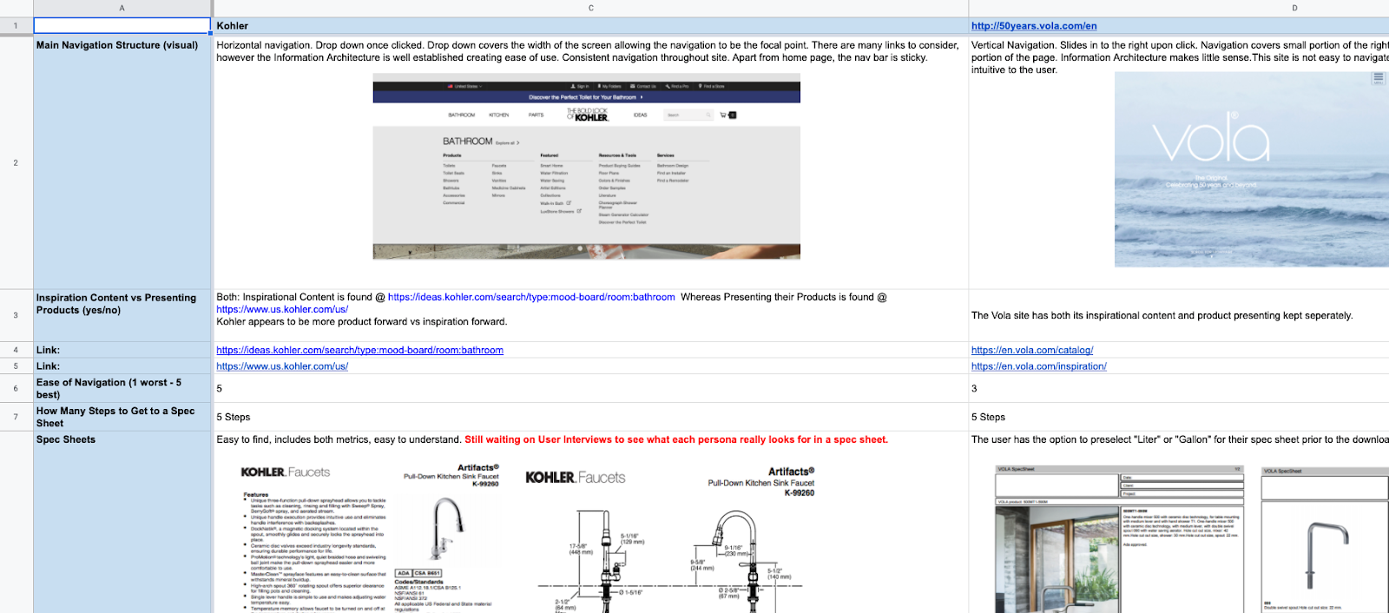
Websites for kitchen and bathroom fixtures: Visual, quantitative, and qualitative competitive analysis

Slide 49
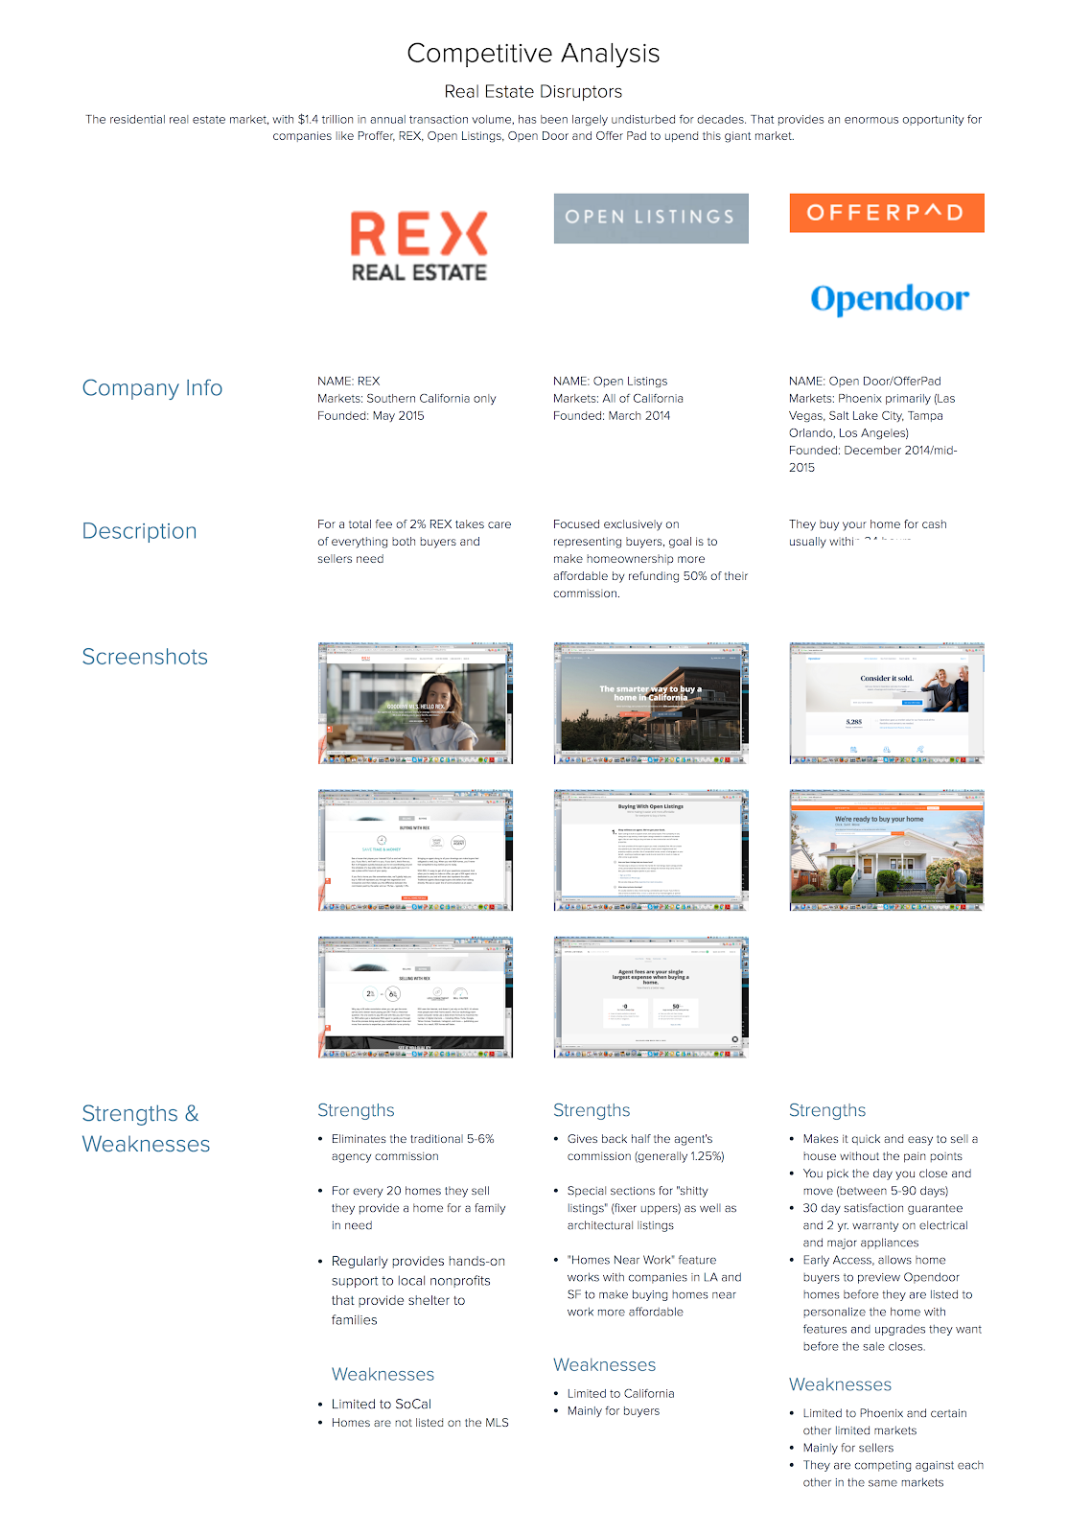
Digital real estate experiences: visual and qualitative competitive analysis

Slide 50
Design Thinking
Human centered approach to innovation
- A process that utilizes empathetic, creative, Innovative and analytical skills to provide solutions to a problem.
Notes:
Design Thinking is a particular style of problem-solving that designers use to ideate. It lays out the connection between a gap in the current state (A problem, if you will) and a solution, and then focuses on developing a creative design that is precise, unique and functional.
http://center10thinking.blogspot.com/2013/07/design-thinking-critical-next-step-for.html
It is founded on two core principles -- care deeply about the people you are designing for (empathy) and try out your ideas long before you think they're ready (prototyping).
It starts with empathy.

Slide 51
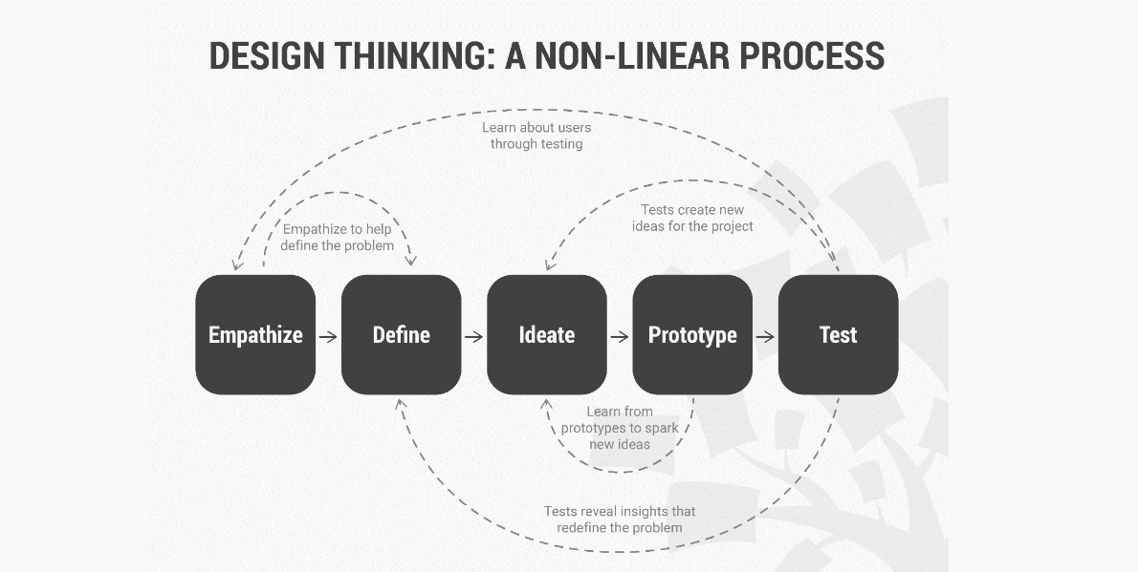

Slide 52
Scenarios and Persona Technique
What are User Scenarios?
A scenario is a situation that captures how users perform tasks on your site or app.
User scenarios describe the user’s motivations for being onsite (their task or goal) and/or a question they need answered, and suggest possible ways to accomplish these objectives.
It is essentially a development of the user story, and can relate to multiple target users.
User scenarios are detailed descriptions of a user – typically a persona – that describe realistic situations relevant to the design of a solution.
By painting a “rich picture” of a set of events, teams can appreciate user interactions in context, helping them to understand the practical needs and behaviors of users.
A scenario derived from a use case.
Use cases are intended to describe all of the possible outcomes from a particular set of events.
The term “scenario” is used in this context to describe just one path – one set of outcomes – through the use case.

Slide 53
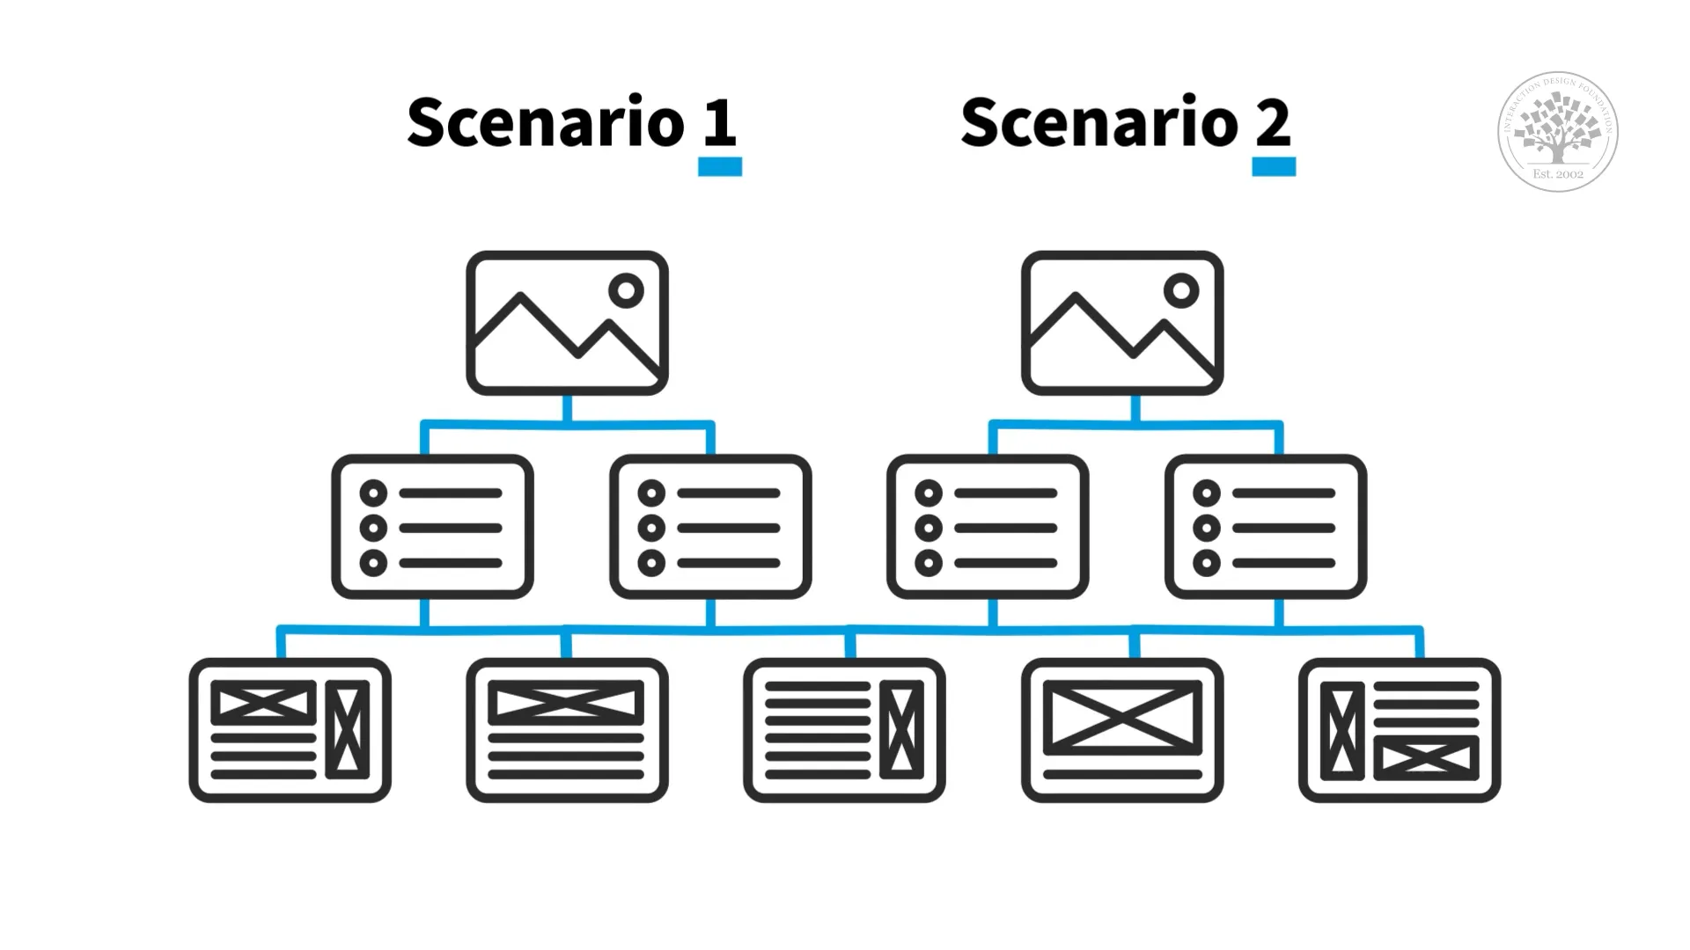
Individual scenarios are usually describing a particular path through an interactive system.

Slide 54
Personas
Personas are fictional characters, which you create based upon your research to represent the different user types that might use your service, product, site, or brand in a similar way.
Creating personas will help you understand your users’ needs, experiences, behaviors and goals.
It can help you recognize that different people have different needs and expectations, and it can also help you identify the user you’re designing for.
Personas make the design task at hand less complex, they guide your ideation processes, and they can help you to achieve the goal of creating a good user experience for your target user group.

Slide 55
Hence, personas do not describe real people, but you compose your personas based on actual data collected from multiple individuals.
Personas add the human touch to what would largely remain cold facts in your research.
Creating persona profiles of typical(average) or atypical (extreme) users will help you understand patterns in your research, which synthesizes the types of people you seek to design for.
In the design thinking process, designers will often start creating personas during the second phase, the Define phase.
Using personas can help designers move on to the third phase, the Ideation phase.

Slide 56

Create a Persona
JOBS TO BE DONE:
NAME:
What does the person want to do with the product/service…what is his/her objective (or goal)
Persona description – Age, gender, residence, occupation, hobbies….
PAIN POINTS
What irritates the person about the Product / service ?
USE CASES:
How is the product/ service used?
By whom?
When?
Where?
How is it bought (paid for)?
Where did the person learn about the product/ service
GAIN POINTS
What are the current support the person has that makes him happy about the product/service?
*It is important to imagine the typical user as a “real person”

Slide 57
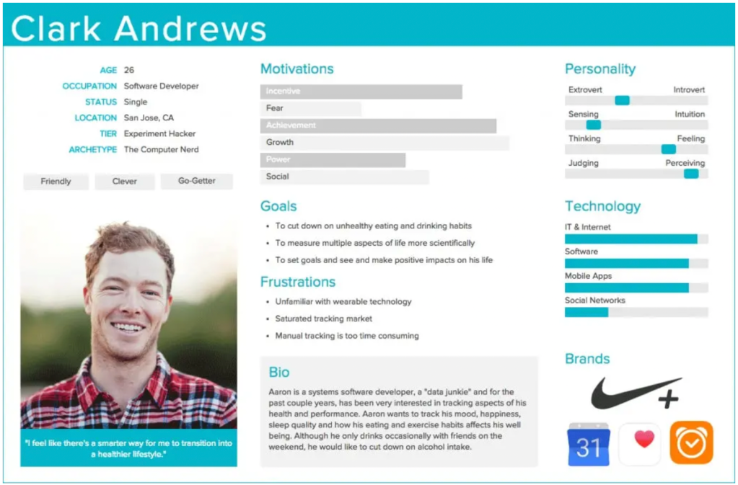

Slide 58
Brainstorming
Brainstorming is an invention and discovery strategy in which the researcher collaborates with others to explore topics, develop ideas, and/or propose solutions to a problem.
It is the process for generating creative ideas and solutions through intensive and freewheeling group discussion.
Every participant is encouraged to think aloud and suggest as many ideas as possible, no matter how seemingly outlandish or bizarre.
The purpose of a brainstorming session is to work as a group to define a problem and find a plan of action to solve it.
Brainstorming aims not just to think of topics to write about but to allow a group to problem-solve when a researcher in the group is, essentially, suffering from a block.

Slide 59
Brainstorming Strategies
Brainstorming strategies are many and varied, but they can be grouped into the following basic areas:
Cubing:
This strategy enables you to consider your topic from six different directions, just as in a cube, which is six-sided.
In cubing, you take an idea and describe it, compare it, associate it, analyze it, apply it, and argue for and against it.
2. Freewriting:
When you freewrite , you let your thoughts flow freely, putting pen to paper (or dry erase pen on a whiteboard) and writing down whatever comes to your mind, or to the group members' minds.
3. Listing:
In this technique, also called bulleting, you jot down broad ideas quickly as they come to your mind in any order.

Slide 60
4.Mapping:
This technique lets you visualize concepts and ideas. Also known as “mind mapping”, this technique starts with a research question or main idea, then adds branches with synonyms, related topic, keywords, and examples.
This method is also called webbing because you end up with something that looks like a spider web with your brainstormed ideas branching out from the main topic in the center.
5.Researching:
Also called the journalistic method, with this technique, you use the “big six” questions that journalists rely on to research a story: who, what, when, where, why, and how.
You and your group then take a few minutes to research the answers to these questions if needed or simply discuss the answers if group members know the information

Slide 61
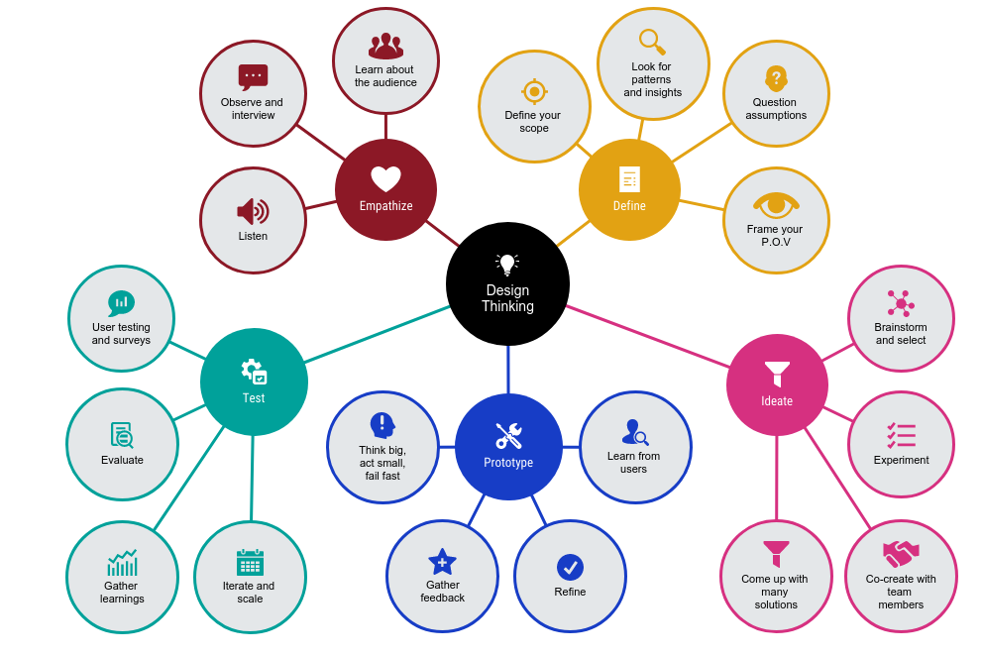
Example of Mind mapping

